Slide 1
Week 4
Bluetooth Communication
Fancy Graphics
Misc. DSP concepts
The FoneAstra
Notes:
Things to improve:
Confusion about copying into/out of OS-provided buffers

Slide 2
Final Projects
I’ve received some questions about this
I’m very open-minded, but you should have ideas by next week
Find a buddy (or two, if you’re ambitious)
Trios will need to do something crazier, as you have more manpower
I’ll want a written report
These are due Tuesday, Feb 10th, but feel free to email them to me early!
No more than one-page summaries please, we’re all busy men/women
Key points your project should hit
Sensing/control (Both would be awesome)
Real-time (or close) computation/processing
Usefulness/”coolness factor” always a plus

Slide 3
Overview
Today we’re going to learn Bluetooth
This will allow us to control separate pieces of hardware
I’ll be handing out Arduinos called the FoneAstra
Onboard BT, SD Card, Buzzer, Battery make it very useful for this class
We have less than 12 FoneAstras
Therefore, you guys are really going to need to pair up and share
Students in the past have purchased their own
So that they can keep them after class and experiment
Talk to me if you want to know which components to buy
Should total no more than $60 dollars overall (pre-tax)

Slide 4
Fancy Graphics
It would be really nice if we could plot things
Turns out, we can!
Drawing to the screen quickly is difficult however
Getting to the point where you can draw a single line takes a LOT of code
DirectX is just as verbose as WASAPI, and there’s even more going on
We’re not going to cover how to do this
We’re just going to use a class I wrote

Slide 5
LineGraph
Uses an Image to output graphics
I’ve made up a C++ component for your use
It uses DirectX to plot a line (400+ lines of C++!)
It’s C++/CX, so you include it via “References”
It’s quite simple to use
Basic procedure:
Include an Image XAML element in your XAML
Include a LineGraph in your C# class
Hook the LineGraph up to the Image as shown in the sample code
Use the functions documented in the LineGraph.h file

Slide 6
LineGraph Live Demo

Slide 7
Asynchronous Tasks
C# has some more goodies for us
Sometimes, we want to execute things asynchronously
But we don’t want/need to do them simultaneously
Enter the async and await keywords
The former modifies function declarations
The latter modifies function calls
private async void myGreatFunction()
{
...
float[] result = await myOtherGreatFunction();
}

Slide 8
Asynchronous Tasks
You must use async on any function with await in it
The await keyword tells the compiler “wait for this”
Execution of the current function stops until done waiting
Execution then resumes
Internally, this is making extensive use of Dispatcher
The compiler reaches a condition inside of an await
Execution stops, all code after the condition is given to the Dispatcher
Eventually, the condition is cleared, and the Dispatcher continues
This is really useful for waiting for external events
Files loading, shaders compiling, network resources arriving, etc…

Slide 9
Asynchronous Tasks
async Task<int> AccessTheWebAsync()
{
HttpClient client = new HttpClient();
Task<string> data = client.GetStringAsync("http://msdn.microsoft.com");
// You can do work here that doesn't rely on [data]
DoIndependentWork();
string urlContents = await data;
// The return statement specifies an integer result.
// Any methods that are awaiting AccessTheWebAsync retrieve the length value.
return urlContents.Length;
}

Slide 10
Asynchronous Tasks
All async methods return a Task
This wraps around the desired return type
Asynchronous methods return before their work is “complete”
This allows synchronous methods to explicitly wait for the condition
Only happens once you access the Result property
private void myGreatFunction()
{
Task<int> taskData = AccessTheWebAsync();
int data = taskData.Result;
}

Slide 11
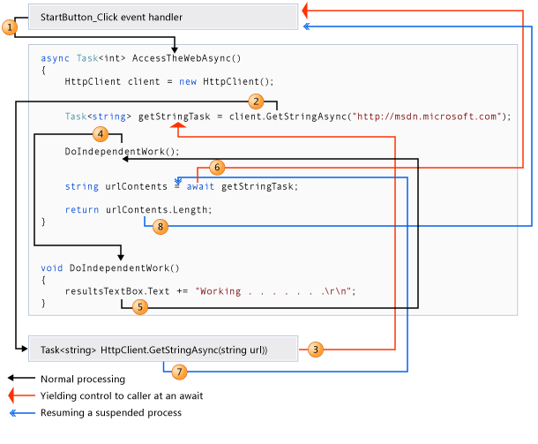
Asynchronous Tasks

Slide 12
Async Live Demo

Slide 13
Bluetooth
A Short-range wireless protocol developed by Intel
Originally designed for The Internet Of Things, Bluetooth’s poster child was a toaster that could burn the weather on your toast in the morning
That it would find a market in cell phones was something of a surprise
After many iterations, now achieves its goal
Low-power, variable bandwidth, short-range, ubiquitous communication
This makes it an attractive choice for many embedded systems
We’re going to use it to control 3rd party hardware
The FoneAstra, a board based on the Arduino
Contains a Bluetooth Module, pins for sensors, an SD Card mount
You are going to write the software for both sides
The Phone to do what it does best; sensing, communication
The Arduino to do anything and everything else

Slide 14
Bluetooth Concepts
To communicate with the Arduino, we must:
Enable Bluetooth on the Phone, and pair it with the Arduino
This is a security measure to ensure Bob doesn’t use Alice’s BT headset by accident: you need to use the proper PIN to connect to it
In practice, almost all “dumb” BT devices use 0000 or 1234 as PIN
Open the Bluetooth interface for communication in the Arduino
Using C, we’ll cover this later
Search for peers, request communication with one in the Phone
Using C#, we’ll cover this next
Write data out to the Bluetooth device, and read data in
On both the Phone and the Arduino

Slide 15
Bluetooth on WP8
Once you turn the Bluetooth on, it’s just “available”
No “initialization” step, other than ensuring that Proximity is checked
There’s also a hidden flag we need to set in our Package manifest
Use the PeerFinder class to search nearby devices
Used to find not only other BT devices, but also specific applications
Operates not only on BT, but also NFC and Wifi
We’re using only BT, so we’ll make sure to specify that
Once you’ve got a Peer, open a StreamSocket
The most basic TCP/Bluetooth communication method
Sends a continuous stream of data
This is as opposed to Datagram-based communication (e.g. UDP)

Slide 16
Streams of Data
Working with Data Streams can be tricky
This idealized “stream” of data is chunked up into packets
These packets are then sent to the BT radio and transmitted
This is done transparently by the operating system
The receiving end is notified at the packet level
There is no way of knowing how much data to wait for
Unless we invent a protocol to give us this knowledge!
…

Slide 17
Streams of Data
Protocols are easy and neat
Example protocol:
First 4 bytes of every message is an integer with size of following data
Next N bytes are the data, where N is the value of the original integer
Interpreting this data is completely up to your application
Another protocol:
Print out data willy-nilly, know it’s done with a newline
Read it in, appending to a buffer until you read in a newline
Additionally, hope that your data itself does not contain a newline
data
data
data
N
N
N
data
data
data
‘\n’
‘\n’
‘\n’

Slide 18
Bluetooth on WP8
First, we tell PeerFinder to find all paired BT devices
PeerFinder.AlternateIdentities["Bluetooth:PAIRED"] = ""
Next, get a list of all peers that satisfy those criteria:
var peers = await PeerFinder.FindAllPeersAsync();
Find the peer we want:
PeerInformation peerInfo = peers.FirstOrDefault(x =>
x.DisplayName.Contains("FoneAstra"));
Connect to that peer if not null
s = new StreamSocket();
await s.ConnectAsync(peerInfo.HostName, "1");
And now we have a socket connected!

Slide 19
Bluetooth on WP8
To send/receive data, we use Data{Writer,Reader}
We build these out of the StreamSocket
DataWriter output = new DataWriter(sock.OutputStream);
DataReader input = new DataReader(sock.InputStream);
To read data in, first Load it, then Read it:
await input.LoadAsync(4);
input.ReadBytes(byteBuffer);
int length = BitConverter.ToInt32(byteBuffer, 0);
To write data out, Write it then Store it:
byte[] data = { 100, 253, 5, 67 };
output.WriteBytes(data);
output.StoreAsync();

Slide 20
Introduction to Arduino
Programming the Arduino is an exercise in Simplicity
It’s straight C/C++, and really easy C++ at that!
Need two functions at minimum:
setup() and loop()
Do Input/Output with the Serial object
Serial.print(“Hello!”)
if( Serial.available() > 0 )
char key = Serial.read()
Output beeps asynchronously with tone()
tone( BUZZER_PIN, 1000, 100 );
delay( 100 );

Slide 21
Introduction to Arduino
Setup is simple, and boilerplate:
#include "foneastrapins.h"
void setup(void) {
//set up the HW UART to communicate with the BT module
Serial.begin(38400);
// Provide power to BT
pinMode(BT_PWR_PIN,OUTPUT);
digitalWrite(BT_PWR_PIN,HIGH);
// Turn on the red light
pinMode(RED_LED_PIN,OUTPUT);
digitalWrite(RED_LED_PIN, HIGH);
}

Slide 22
BT/Arduino Live Demo

Slide 23
Matched Filtering
Matched Filtering is a signal detection technique
Uses convolution to find precise location in time of a known signal
Used extensively in communications applications
Can be used to drastically increase signal-to-noise ratio
Very useful for attempting to find a preamble
Based on convolution, everyone’s favorite

Slide 24
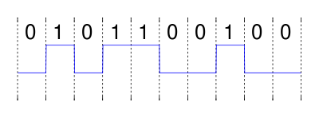
Matched Filtering
Basic idea is to have a “template” signal:
We convolve this with the input datastream
NOTE: In this case we don’t want to flip and shift, just shift
So if you’re using a filter object that flips for you, un-do that by flipping first
As we convolve, we look for when the result is large

Slide 25
Matched Filtering
Shift and dot-product:
= 1

Slide 26
Matched Filtering
Shift and dot-product:
= 1

Slide 27
Matched Filtering
Shift and dot-product:
= 4

Slide 28
Matched Filtering
Shift and dot-product:
= 1

Slide 29
Matched Filtering
Shift and dot-product:
= 1

Slide 30
Matched Filtering
This works best with certain templates
In particular; their autocorrelation functions should be a delta
It works “okay” with other signals
As long as your target signal is more-or-less orthogonal to interferers
That’s quite a broad category
We’re going to use it with a terrible choice of filter
A sinusoid
We’re going to see that it still kinda works

Slide 31
Homework 4
Due to popular demand, is due at 6pm next Thursday
Enjoy your extra 18 hours, but please don’t ask for help at 4pm on Thursday
This homework will involve everything we just learned
Send messages to the Arduino over BT, making it beep in a certain pattern
Detect the beepings of the Arduino by analyzing the audio stream
Reconstruct the message you sent over Bluetooth
We’ll translate the message into BFSK pulses
E.g. sinusoids at different frequencies

Slide 32
Homework 4
There are multiple ways we could do this homework
Just beep for ones and zeros, hope we catch them when they occur.
Have a “preamble” that allows accurate timing synchronization
Follow this preamble up with a data segment
The solution transmits a single bit per “packet”
Packet has a preamble, 4.5 KHz signal for 5 ms
Silence for 50 ms
Packet then has a data bit
0 -> 3.4 KHz signal for 50 ms
1 -> 4.5 KHz signal for 50 ms
Feel free to be more adventurous

Slide 33
Homework 4 Demo

Slide 34
FFTW
We have a C++/CX class that can do FFT’s
Internally uses the FFTW library, a very well-known opensource C++ library
Very straightforward to use
Since it’s C++/CX, it will deal in C# arrays, so we can use it from C#
A few functions of merit:
fft()
ifft()
fftMag()
fftLogMag()
Combine this with LineGraph for hours of fun

Slide 35
Using the FoneAstra
It’s built out of an Arduino Pro 3.3V w/ ATMega328
Eratta:
Set the Arduino IDE to the correct Arduino before trying to upload code
You might also need the FTDI drivers
Upload code via the inner TTL header
Bluetooth won’t be able to transmit/receive if that is still plugged in
On the other hand, you can simulate bluetooth with that plug
To get BT to work, disconnect your TTL cable and powercycle
If your Arduino has a Bluetooth name like “RN-XXXX”, bring it to me
It should say “FoneAstra–XXXX” where XXXX is the last four digits of your bluetooth address, written on the bottom of the FoneAstra

Slide 36
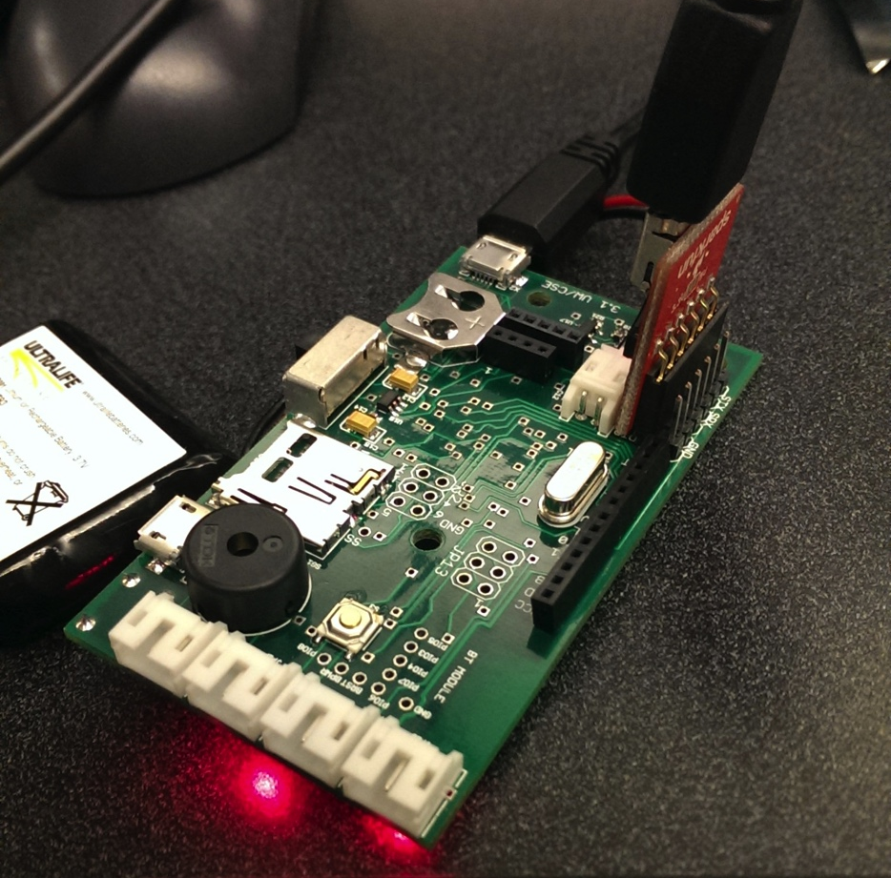
Using the FoneAstra

Slide 37
Debugging BT
This can be frustrating if something isn’t working
Note that you can’t read in from BT on the Arduino if the USB is plugged in!
USB serial output on the Arduino is a great tool
Open the Serial Terminal in the Arduino IDE
Allows you to print out data from the Arduino
Can print out to two separate Serial interfaces:
Main Serial: What you see on the programming serial interface
Also gets copied out to Bluetooth
Software Serial: What you see on the second serial interface

Slide 38
Building your own
Arduino ($25 on Amazon)
BT Module ($9 on Amazon)
USB to TTL converter ($20 on Amazon)
Battery with female JST connector (?)
SD Card Module (?)
Feel free to substitute your own favorite parts
You could conceivably get cheaper parts, esp. in the USB -> TTL dept.
These are the ones I know work, using other parts YMMV

